Slide 1

Russian Twitter Trolls Network Analysis before USA elections in 2014
Hubert Ruczyński

Slide 2
Data quality of nodes
453 accounts, described with 14 features.
Accounts mostly declare English, and then Russian languages.
Most columns are of high quality – Russian texts are issues.
All nodes only have screen_name, and sometimes the rest is empty.
We should use screen_name as id.

Slide 3
Data quality of tweets
203,451 tweets, described with 16 features.
We can map accounts with tweets: user_key and lowercase screen_name.
Retweet_count is null when retweeted is empty.
Columns like poster, source, and expanded_url, are meaningless.
Some tweets don’t have their own IDs.
Multiple tweets with the same tweet_id, and retweeted_status_id
Notes:
Thanks to these tests, I decided that I’ll create a network, where the edges will represent retweeting mechanisms. Additionally, I will keep only those tweets that retwitted or were retweeted, in order to limit the study.

Slide 4
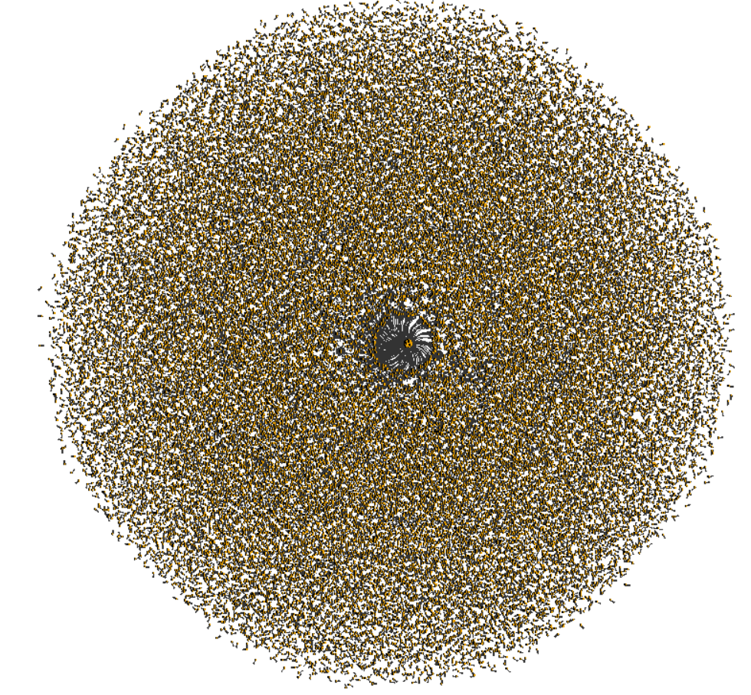
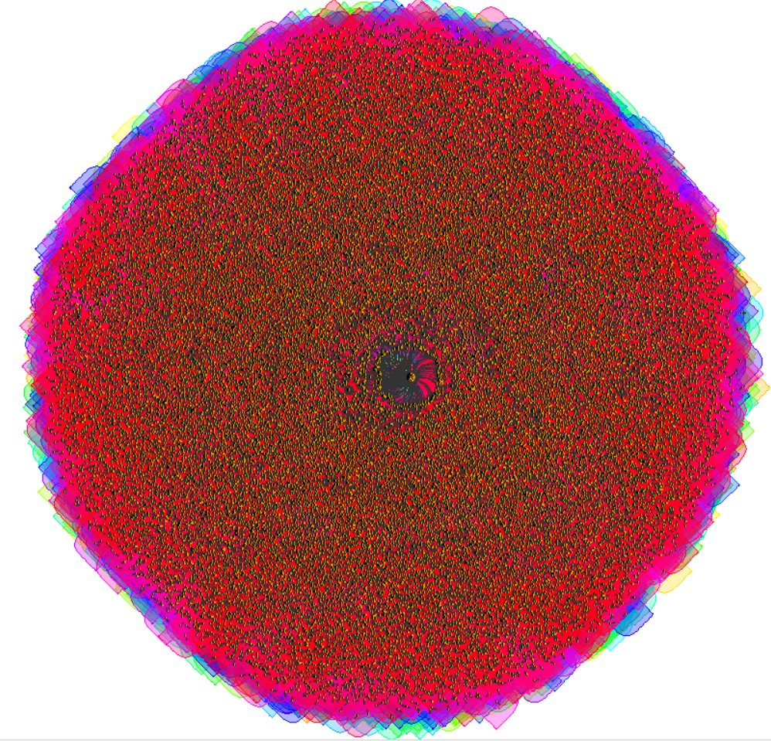
Tweet-centered approach
Notes:
The first approach focused on analyzing the retweeting mechanism between particular tweets. It was unsuccessful, due to the fact that there were tens of thousands of tweets. The only visible thing was a cluster of tweets in the middle of the network, and the existence of a ring, close to it.
Additionally, the cluster analysis didn’t help at all, as they were heavily overlapping.

Slide 5
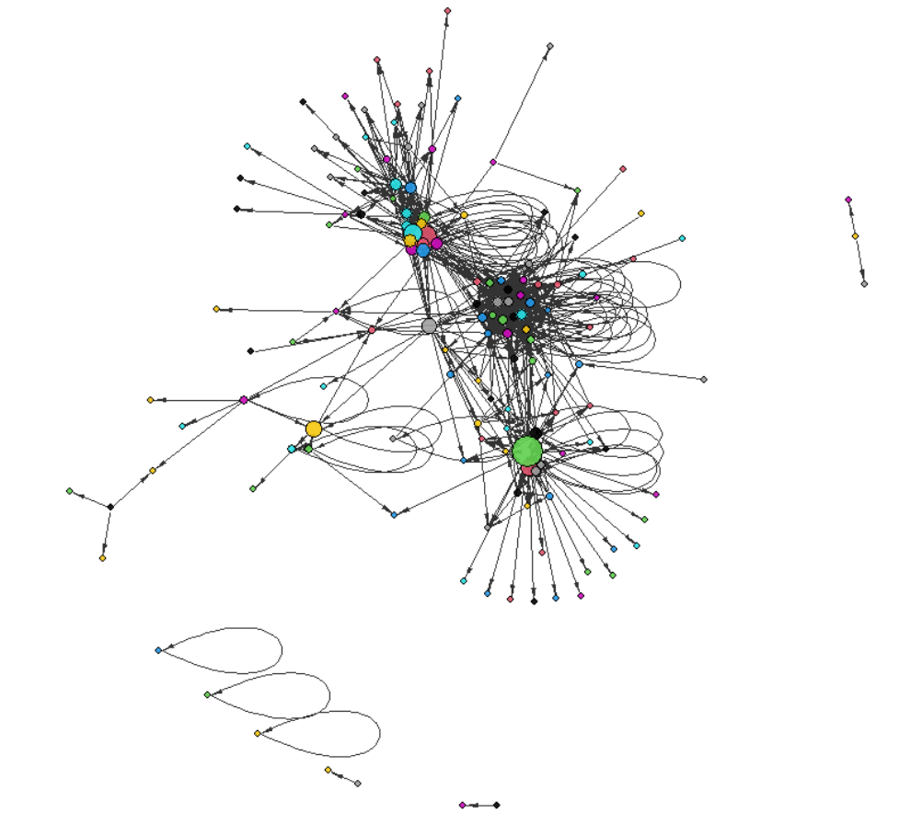
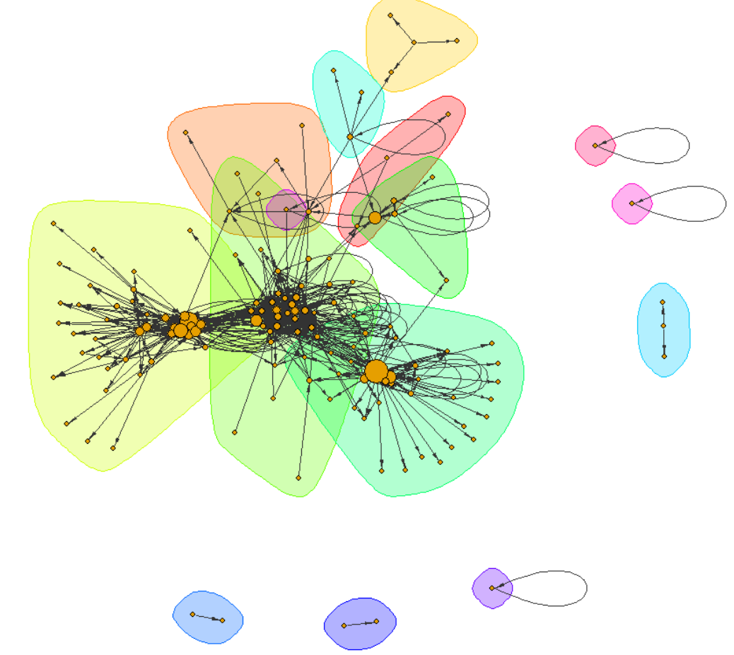
User-centered approach
Notes:
In the second approach, I decided to map the tweets to the users, by replacing the mechanism of retweeting relations from tweet to tweet with the relations user to user. This way I was able to analyse the trolls themselves.
The results are much more readable than before, and even from the first plot we can see some kinds of clusters.
After conducting a community detection algorithm, we can outline 3 major communities: yellow, warm green, and cold green ones. They represent 3 types of troll accounts.

Slide 6
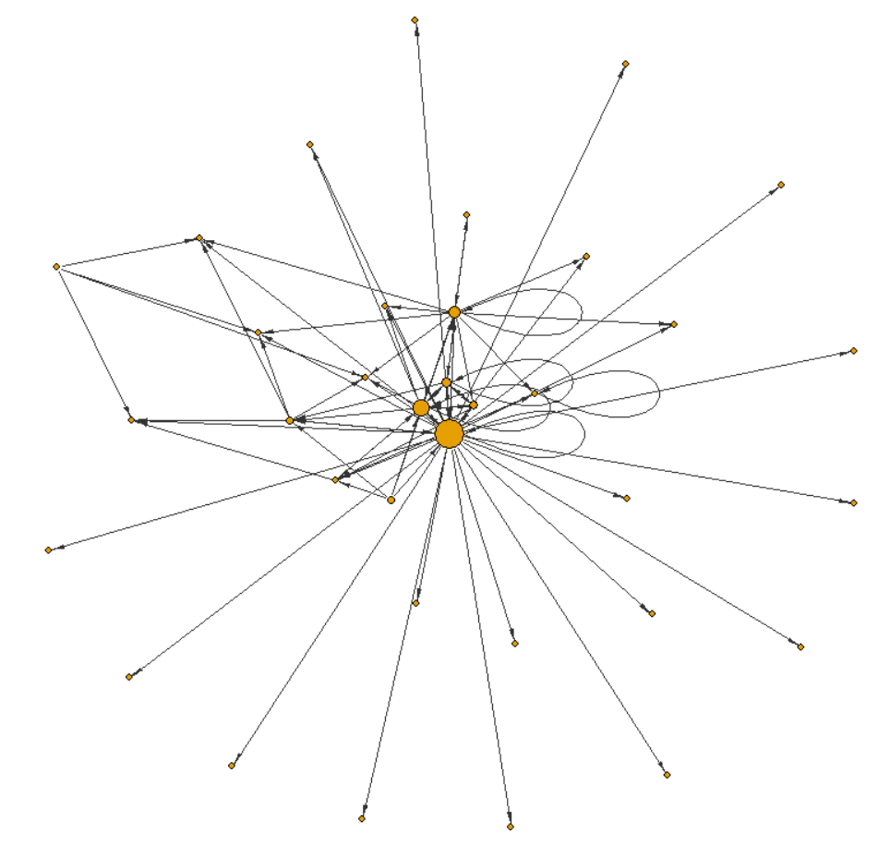
Troll type – Fake news centre
Top 5 hashtags:
#birtherism
#DemsInPhilly
#BasementDwellers
#Benghazi
#HillarysHealth
Leader: ten_gop

Slide 7
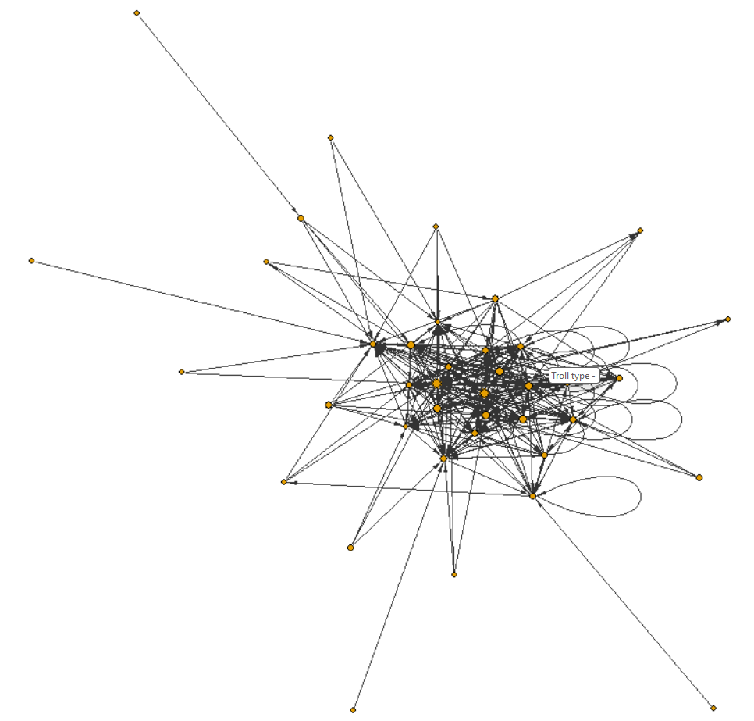
Troll type – retweet group
Top 5 hashtags:
#OscarsSoWhite
#HappyBirthdayHarryTruman
#NoCyberCensorship
#ThingsMoreTrustedThanHillary
#Guns4NY

Slide 8
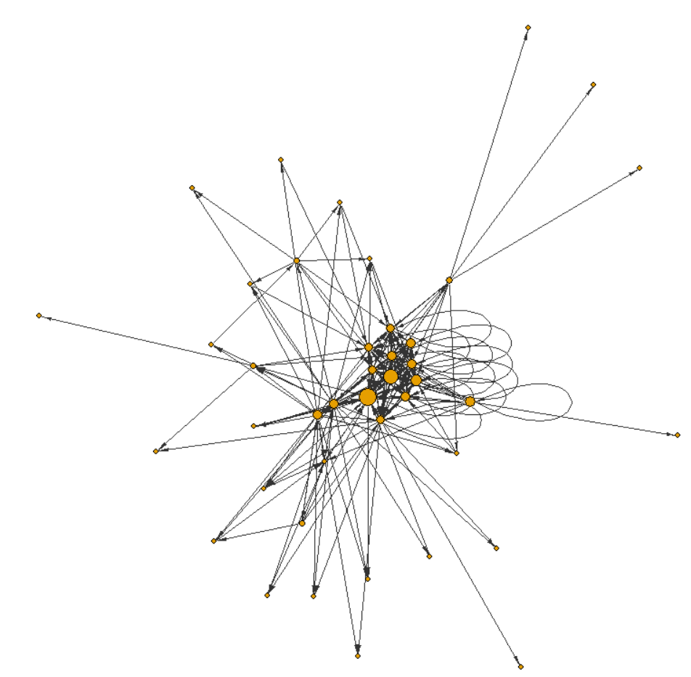
Troll type – retweet group with leaders
Top 5 hashtags:
#BetterAlternativeToDebates
#SurvivalGuideToThanksgiving
#RejectedDebateTopics
#IHaveARightToKnow
#ThingsYouCantIgnore

Slide 9
Thank you for your attention!

